Slide 1
Agile SDLC Model

Slide 2
Agile SDLC Model
Agile is a philosophy, not a specific development approach.
Agile is group of methodologies that values a pragmatic mindset and flexible approach.
Agile is a time-bound, iterative approach to software delivery that builds software incrementally from the start of the project, instead of trying to deliver all at once.

Slide 3

Agile SDLC Model
Scrum
Etc.,
Xp
Kanban
Lean
Maximize customer satisfaction through early delivery of software.
Small, highly motivated project teams; informal methods; minimal software engineering work products. And overall development simplicity.

Slide 4
Who does it in Agile
Client
Agile
SDLC
Software engineers
Stakeholders
End users

Slide 5
What is Agility?
An agile team is a nimble team that responds appropriately to changes.
Change is what software development is very much about.
Changes in the software being built (team members, new technology, and all kinds).

Slide 6
Traditional Project Management versus Agile Project Management
Traditional | Agile
Design up front | Continuous design
Fixed scope | Flexible
Deliverables | Features/requirements
Freeze design as early as possible | Freeze design as late as possible
Low uncertainty | High uncertainty
Avoid change | Embrace change
Low customer interaction | High customer interaction
Conventional project teams | Self-organized project teams

Slide 7
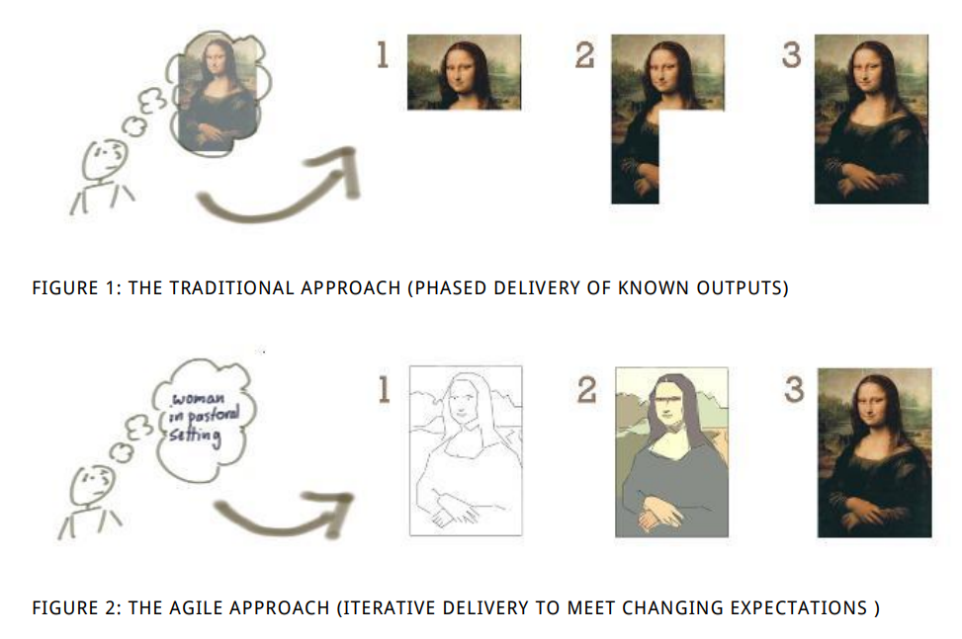
Traditional Project Management versus Agile Project Management

Slide 8
Agility Principles
Our highest priority is to satisfy the customer through early and continuous delivery of valuable software.
Welcome changing requirements, even late in development.
Deliver working software frequently.
Business people and developers must work together daily.
Build projects around motivated individuals.
Development team is face-to-face conversation.

Slide 9
Agility Principles
Working software is the primary measure of progress.
Agile processes promote sustainable development.
Continuous attention to technical excellence and good design enhances agility.
Simplicity
The best architectures, requirements, and designs emerge from self–organizing teams.
At regular intervals, the team reflects on how to become more effective, then tunes and adjusts its behavior accordingly.

Slide 10
Agile Project Management Principles
Focus on customer value
Iterative and incremental delivery
Continuous improvement
Agile Principles
Self-organization
Experimentation and adaptation

Slide 11
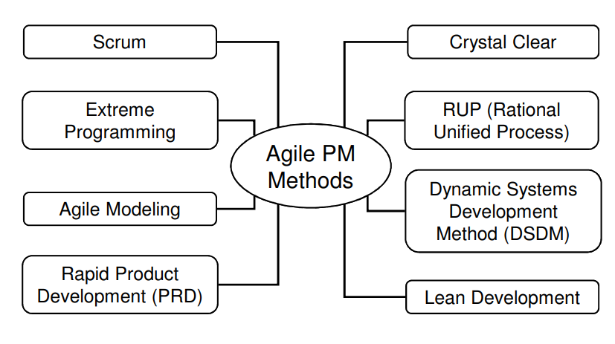
Popular Agile Methods

Slide 12
Scrum
Agile scrum methodology is a project management system that relies on incremental development.
Scrum is an adaptable, fast, flexible and effective agile framework that is designed to deliver value to the customer throughout the development of the project.
The development starts from a general idea of ​​what needs to be built, elaborating a list of characteristics ordered by priority (product backlog) that the owner of the product wants to obtain.

Slide 13
Scrum Cont’d
The three primary roles within the Scrum framework
The product owner who represents the stakeholders,
The scrum master who manages the team and the Scrum process.
The team, about 7 people, who develop the software.

Slide 14
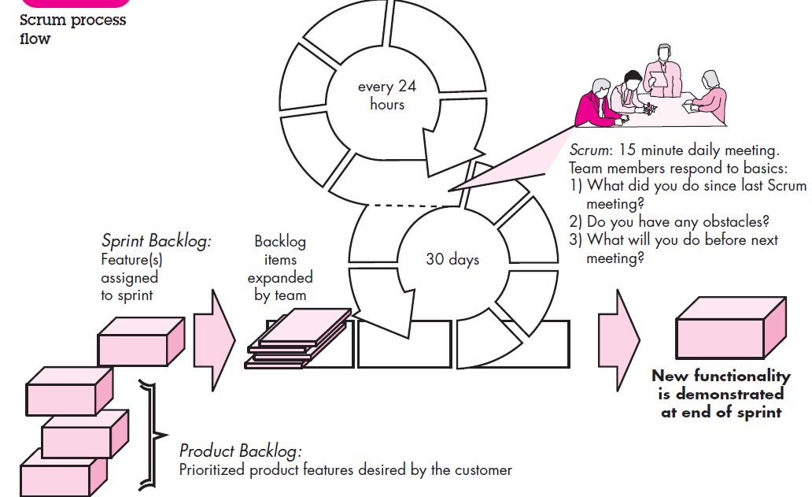

Slide 15
Process Patterns
Backlog—a prioritized list of project requirements or features that provide business value for the customer.
Items can be added to the backlog at any time (this is how changes are introduced).
The product manager assesses the backlog and updates priorities as required.

Slide 16
Process Patterns
Sprints—consist of work units that are required to achieve a requirement defined in the backlog that must be fit into a predefined time box (typically 30 days).
Changes (e.g., backlog work items) are not introduced during the sprint.

Slide 17
Scrum meetings
short (typically 15 minutes) meetings held daily by the Scrum team.
Three key questions are asked and answered by all team members.
What did you do since the last team meeting?
What obstacles are you encountering?
What do you plan to accomplish by the next team meeting?

Slide 18
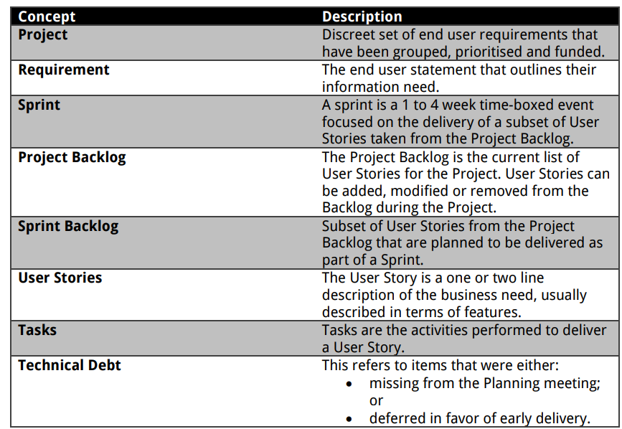
Scrum Key Concepts

Slide 19
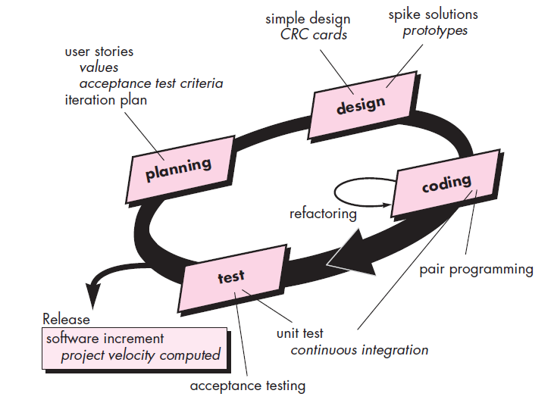
The Extreme Programming Process (XP)

Slide 20
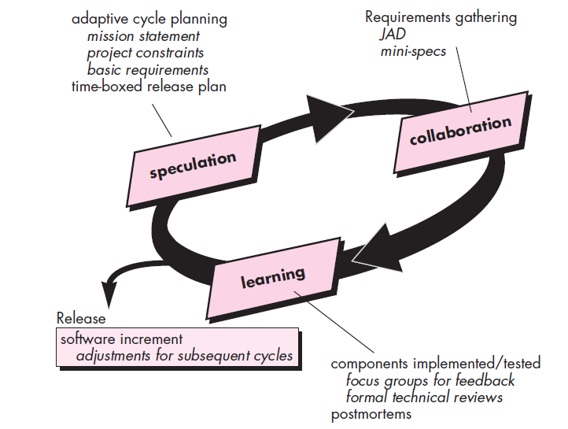
Adaptive Software Development (ASD)

Slide 21
Key Points in Agile
Iterative design process.
Continuous stakeholder engagement.
Aims for quality and reliable software.
Short development cycles (up to a month) allow to the regular delivery of software.

